Slide 1
LECTURE 5

Slide 2

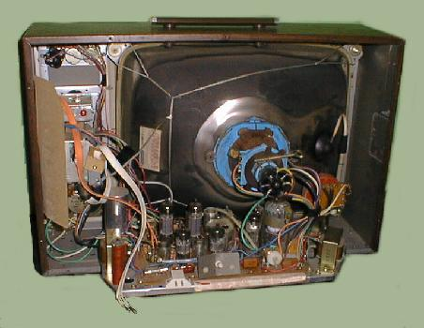
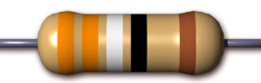
A device like television which is
a combination of many components.
Old CRT television
Picture tube
By using resistors
Speaker
How can different current be provided to different components ?
Every component requires a different amount of current
Basic power circuit

Slide 3
Resistances can be connected in two ways
Voltage
drop
Potential
difference
SERIES
PARALLEL
Current gets
divided but potential difference remains the same
One after the other
Between two common points
Current in the circuit remains the same
R₁
R₁
R₂
R₃
A
R₂
B
R₃
+
-
+
–

Slide 4

V = V₁ + V₂ + V₃
…..…(i)
+
–
+
–
+
–
+
–
According to OHM’S LAW,
V
V
V
V
V = IR_{s}
,V₁ = IR₁
, V₂ = IR₂
& V₃ = IR₃
R₁
R₂
R₃
A
B
Substituting the values of V, V₁, V₂ and V₃ in equation (i), we get
V₁
V₂
V₃
–
V
IR_{S} = IR₁ + IR₂ + IR₃
DERIVE A FORMULA FOR EFFECTIVE RESISTANCE
FOR THREE RESISTANCES CONNECTED IN SERIES AND PROVE THAT
R_{S} = R₁ + R₂ + R₃
A
∴ IR_{S} = I (R₁ + R₂ + R₃)
+
+
–
∴ R_{S} = R₁ + R₂ + R₃
Where R_{S} is the
I
K
E
“Effective Resistance in Series”.
For ‘n’ number of resistances, we have
R_{S} = R₁ + R₂ + R₃ + ………. + R_{n}
Effective Resistance in series (R_{S}) is the sum of the individual resistances.

Slide 5

Draw this diagram and make the required corrections
+
–
A
V
A
B
–
+
V
A
+
-
+
–
I
K
E
Plug key should be closed

Slide 6

Write the derivation of resistance in series
V = V₁ + V₂ + V₃
…..…(i)
According to OHM’S LAW,
00:
3:
2:
1:
00
00
59
58
57
56
55
54
53
52
51
50
49
48
47
46
45
44
43
42
41
40
39
38
37
36
35
34
33
32
31
30
29
28
27
26
25
24
23
22
21
20
19
18
17
16
15
14
13
12
11
10
09
08
07
06
05
04
03
02
01
00
59
58
57
56
55
54
53
52
51
50
49
48
47
46
45
44
43
42
41
40
39
38
37
36
35
34
33
32
31
30
29
28
27
26
25
24
23
22
21
20
19
18
17
16
15
14
13
12
11
10
09
08
07
06
05
04
03
02
01
00
59
58
57
56
55
54
53
52
51
50
49
48
47
46
45
44
43
42
41
40
39
38
37
36
35
34
33
32
31
30
29
28
27
26
25
24
23
22
21
20
19
18
17
16
15
14
13
12
11
10
09
08
07
06
05
04
03
02
01
V = IR_{s}
,V₁ = IR₁
, V₂ = IR₂
& V₃ = IR₃
Substituting the values of V, V₁, V₂ and V₃ in equation (i), we get
IR_{S} = IR₁ + IR₂ + IR₃
∴ IR_{S} = I (R₁ + R₂ + R₃)
∴ R_{S} = R₁ + R₂ + R₃
Where R_{S} is the
“Effective Resistance in Series”.
For ‘n’ number of resistances, we have
R_{S} = R₁ + R₂ + R₃ + ………. + R_{n}
Effective Resistance in series (R_{S}) is the sum of the individual resistances.

Slide 7
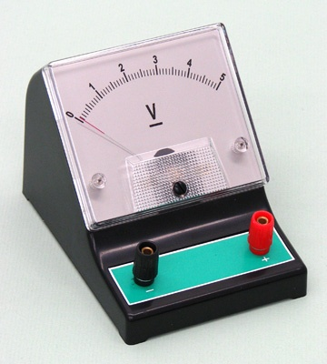
I = I₁ + I₂ + I₃
(i)
Activity 4.9
V
–
+
According to OHM’S LAW,
R₁
+
A
–
V
V
V
V
V = IR,
I =
,I₁ =
,I₂ =
,I₃ =
I₁
R₂
R_{p}
R₁
R₂
R₃
+
–
A
Substituting the values of I, I₁, I₂ and
C
I₂
D
–
R₃
I₃ in equation (i),
we get
–
+
A
I₃
A
V
V
V
V
=
+
material having infinite resistance
+
+
DERIVE A FORMULA FOR EFFECTIVE RESISTANCE FOR THREE RESISTANCES CONNECTED IN PARALLEL AND PROVE THAT
1/R_{P} = 1/ R₁ + 1/R₂ + 1/R₃
R_{P}
R₁
R₂
R₃
.
+
–
( )
V
1
1
1
I
K
E
∴
=
V
+
+
R_{P}
R₁
R₂
R₃
The reciprocal of Effective Resistance in Parallel (R_{p}) is the sum of the reciprocals of the individual resistances.
1
1
1
1
∴
=
+
+
R_{P}
R₁
R₂
R₃
Where R_{P} is the “Effective Resistance in Parallel”.
For ‘n’ number of resistances, we have
1/R_{P} = 1/R₁ + 1/R₂ + 1/R₃ + ……………. + 1/R_{n}
Voltmeter

Slide 8
Write the derivation of resistance in parallel
I₁
I₂
I = ___ + ___ + I₃
(i)
According to OHM’S LAW,
00:
3:
2:
1:
00
00
59
58
57
56
55
54
53
52
51
50
49
48
47
46
45
44
43
42
41
40
39
38
37
36
35
34
33
32
31
30
29
28
27
26
25
24
23
22
21
20
19
18
17
16
15
14
13
12
11
10
09
08
07
06
05
04
03
02
01
00
59
58
57
56
55
54
53
52
51
50
49
48
47
46
45
44
43
42
41
40
39
38
37
36
35
34
33
32
31
30
29
28
27
26
25
24
23
22
21
20
19
18
17
16
15
14
13
12
11
10
09
08
07
06
05
04
03
02
01
00
59
58
57
56
55
54
53
52
51
50
49
48
47
46
45
44
43
42
41
40
39
38
37
36
35
34
33
32
31
30
29
28
27
26
25
24
23
22
21
20
19
18
17
16
15
14
13
12
11
10
09
08
07
06
05
04
03
02
V
R₂
V
R₃
01
I = __/R_{p}
,I₁ = V/R₁
,I₂ = V/__
& I₃ = __/__
Substituting the values of I, I₁, I₂ and I₃ in equation (i), we get
V
R₂
V
R₃
V/R_{p} = __/R₁ + V/____ + ___/___
1/R₁
1/R₂
1/R₃
∴ V/R_{p} = V(____ + ______ +_____)
1/R₂
1/R₃
∴ 1/R_{p} = 1/R₁ + _____ + _____
Where R_{p} is the
“Effective Resistance in Parallel”.
For ‘n’ number of resistances, we have
1/R_{p} = 1/R₁ + 1/R₂ +1/R₃ + ………. + 1/R_{n}
The reciprocal of Effective Resistance in parallel (R_{p}) is the sum of reciprocal of individual resistances.

Slide 9


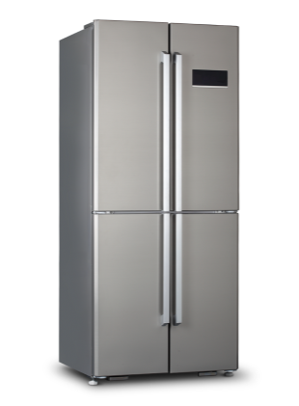
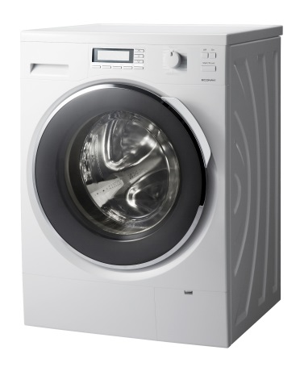
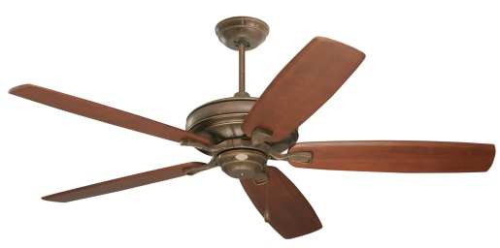
How are the appliances connected at home, series or parallel

Slide 10
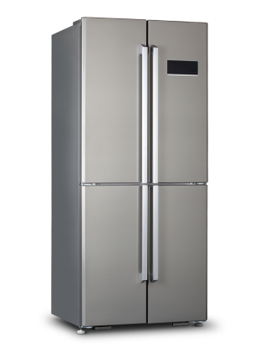





What will happen, if appliances (resistors) are connected in series ?
Same current flows through fridge, T.V. & iron
Hence at home appliances are not connected in series.
So if one appliance switched off, all appliances will be off.
MAIN SUPPLY

Slide 11

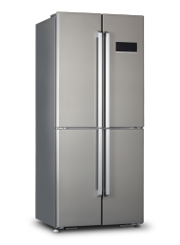

What will happen, if appliances (resistors) are connected in parallel ?
So if one appliance switched off, another appliances will still work
Hence at home appliances are connected in parallel.
Different current flows through fridge, T.V. & iron
MAIN SUPPLY

Slide 12

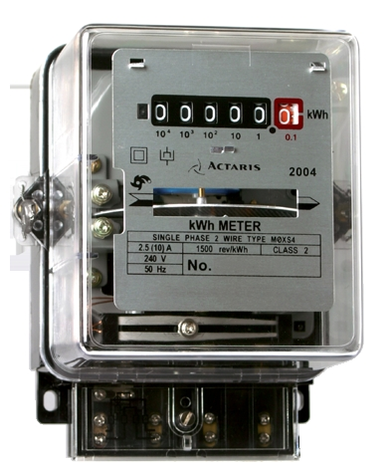
How is meter at our home connected ?
How are appliances connected
in drawing room ?
Series
Series
Parallel
Parallel
The current that flows in our house has to flow from meter
Mixed
Mixed
If one switch is on, only one appliance will work.

Slide 13
Q.1.
What are the advantages of connecting electrical devices in parallel with the battery instead of connecting them in series?
Ans. :
When a number of electrical devices are connected in parallel, each device gets the same potential as the supplied voltage. Due to this, other devices are not affected if one device fails. In series connection, if one device fails, the circuit breaks and others stop working.
The parallel circuit divides the current through the electrical devices. Thus each device gets proper current depending on its resistance. Whereas, in series circuit, same current flows through all the devices, irrespective of their resistance.
The total circuit resistance can be reduced by connecting the devices in parallel.

Slide 14
Thank You

